Slide 1


Slide 2
Revision of Research Basics
Research:
  Should be about some problem that encourages enthusiasm (for you) and interest (for others)
  Is often generated from the thought “what we’ve got now/from the past isn’t quite right/good enough – we can do better…”
  Consists of work that leads to a meaningful contribution
  Generates, in some way, a better solution to the problem

Slide 3
Writing the Introduction

Slide 4
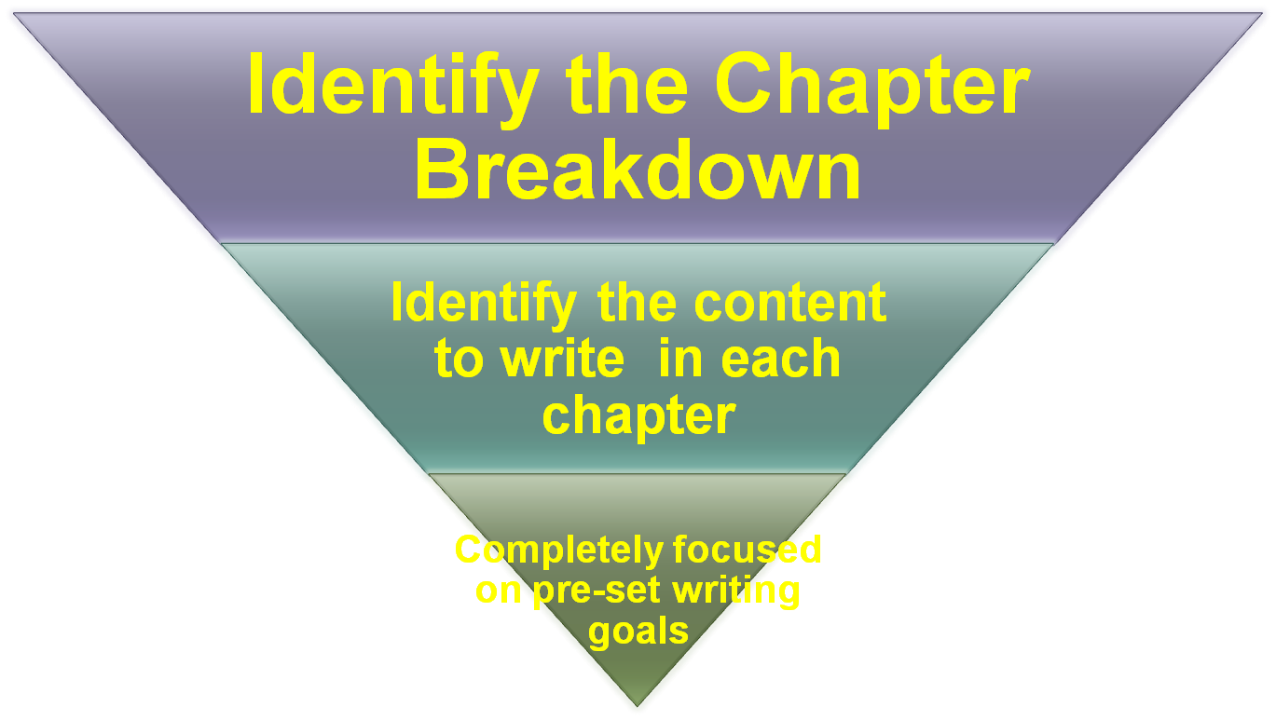
Top Down Approach (Writing Approach)

Slide 5
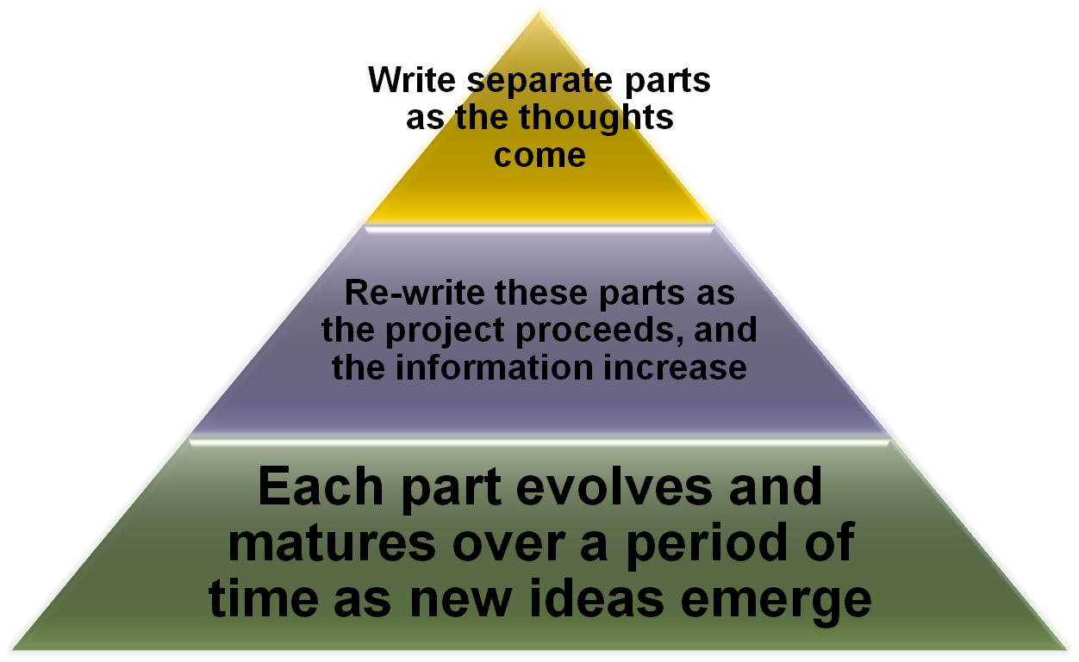
Bottom Up Approach (writing approach)

Slide 6
Approaches to Writing
Inverted Pyramid

Slide 7
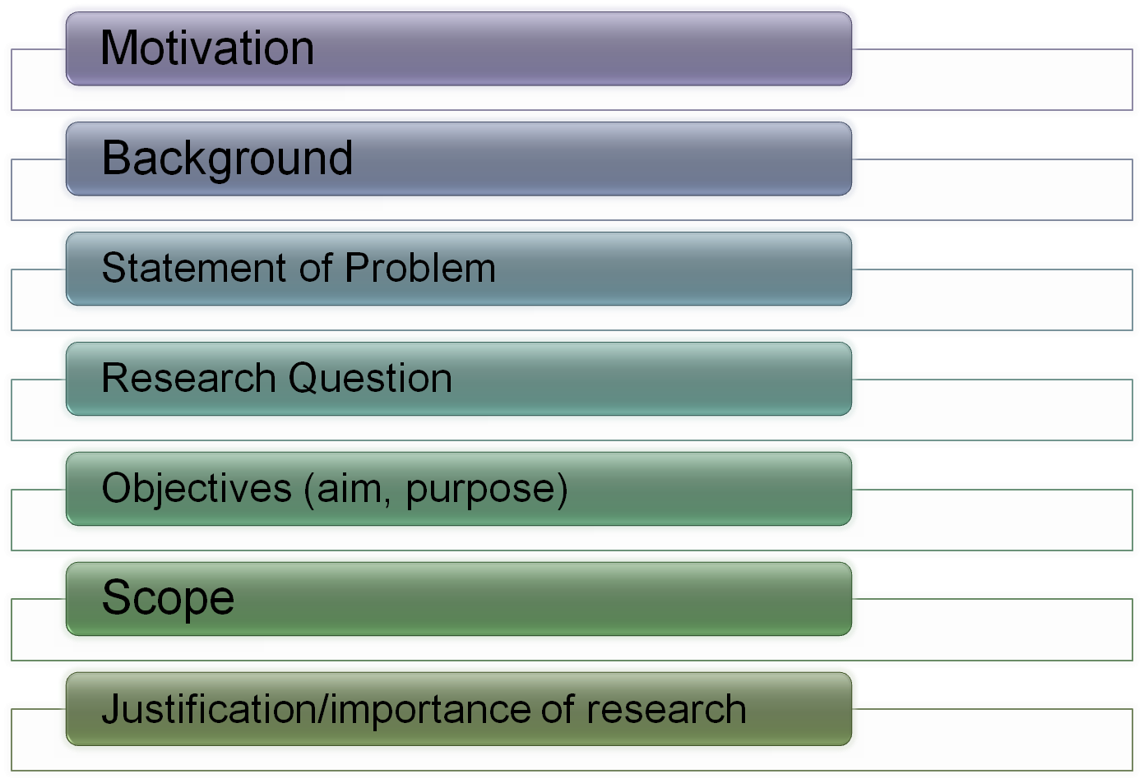
Introduction

Slide 8
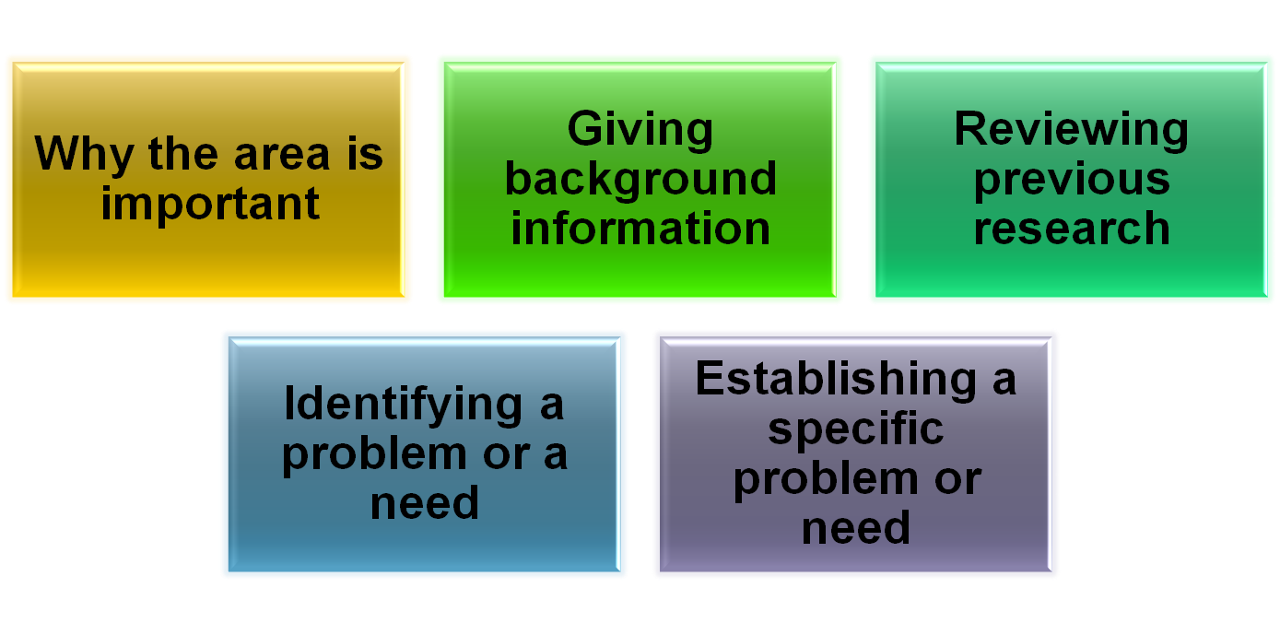
Motivation
Do not make headings for the following; just include discussion on the following items,
End it with statement of the problem

Slide 9
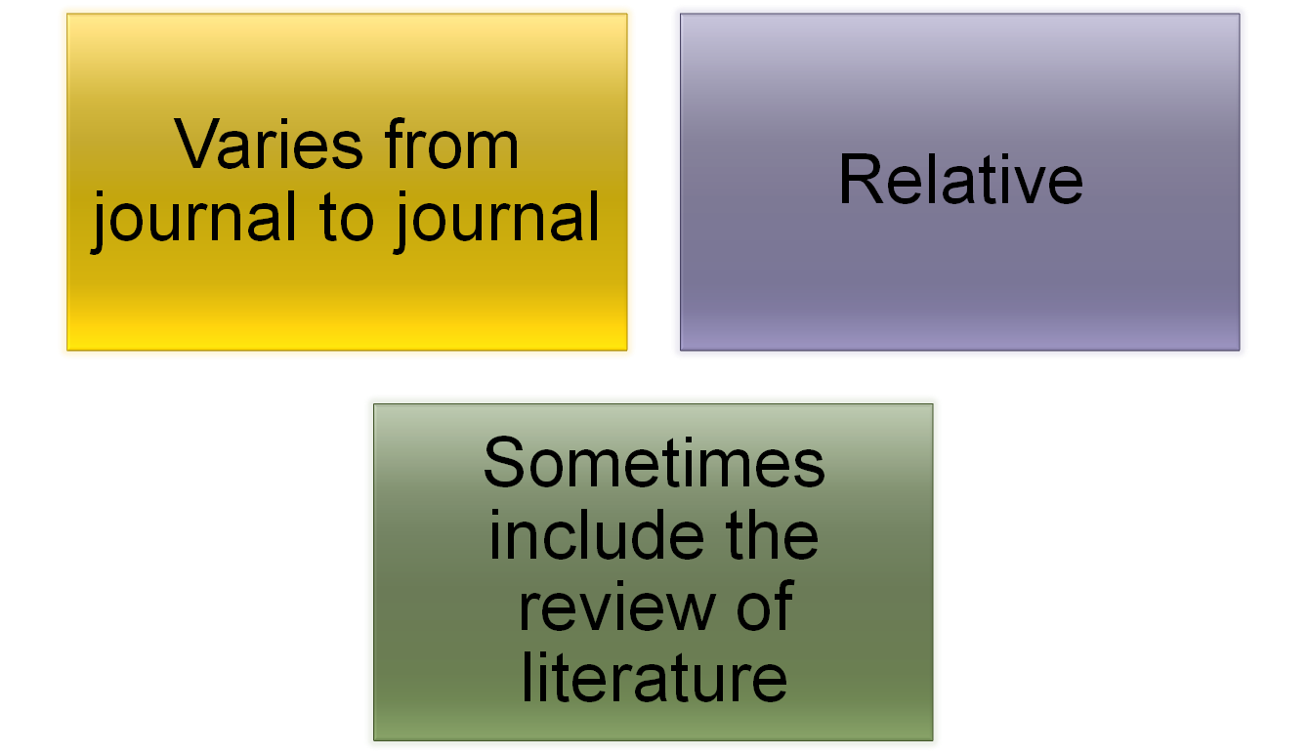
Background

Slide 10
Statement of problem
Handout II-Page number
Study the template of problem statement.

Slide 11
Research Question

Slide 12
Statement of Purpose
A Broad statement (using a few sentences);
States what you want to learn/figure out/solve through the project/research
Guides you as you read and take notes only on what's needed for your project.
Indicates the goals of the project

Slide 13
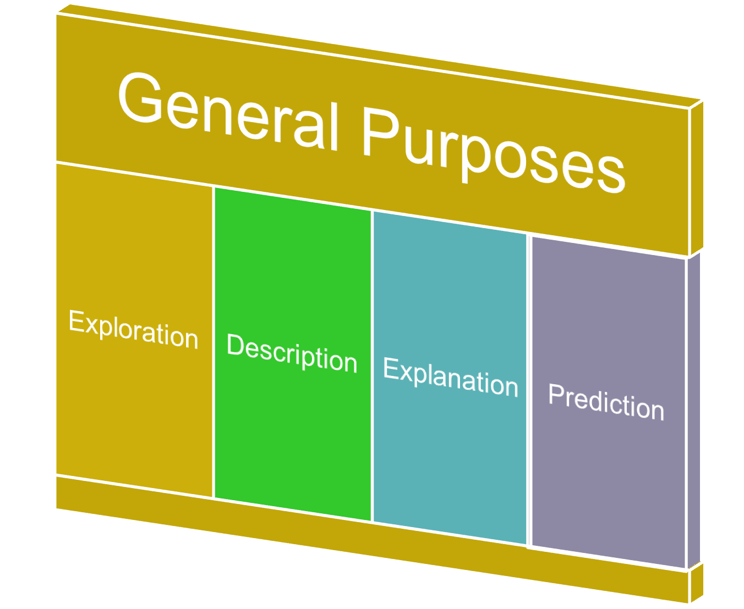

Slide 14
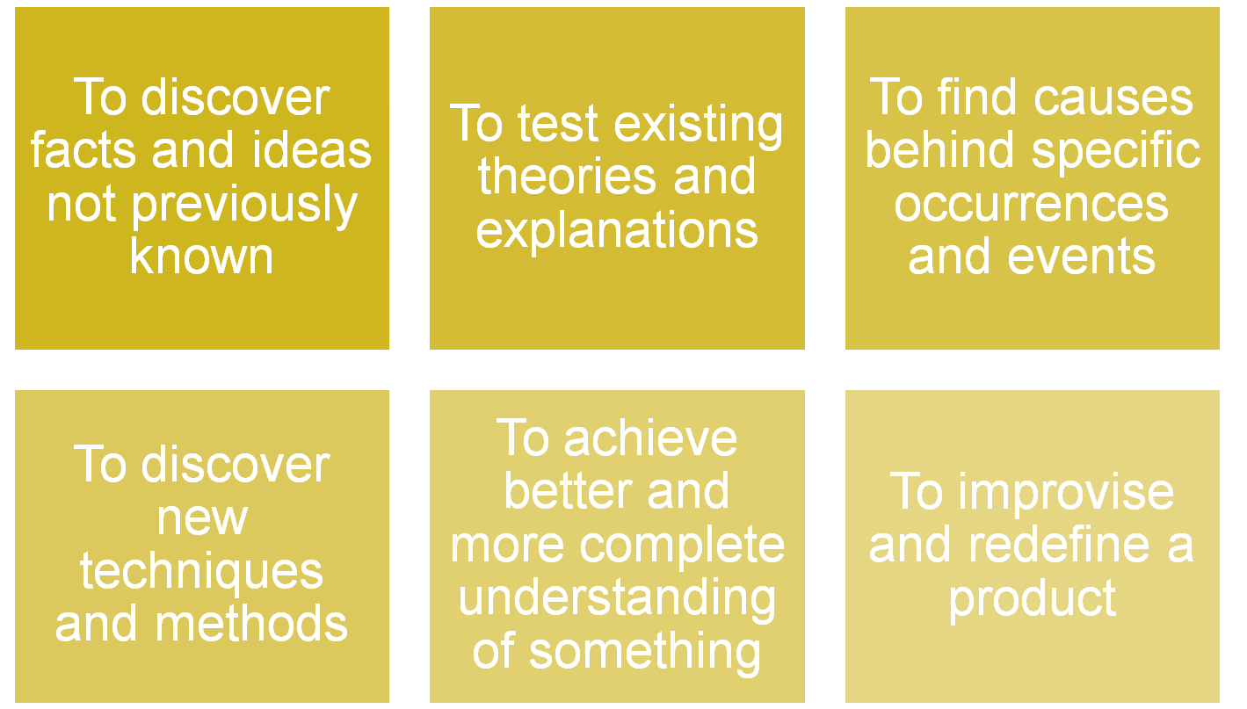
Specific Purposes

Slide 15
Statement of Purpose
Questions to ask yourself
1. What is my real personal interest in the topic?
2. What do I specifically want to learn about my topic?

Slide 16
Statement of purpose
Statement of purpose 1:
The purpose of this paper is to learn about the practical measures implemented by the government to curb environmental pollution

Slide 17
From Purpose to Thesis Statement
Statement of Purpose will eventually lead to a Thesis Statement in which she will be able to make an assertion
(a statement she can defend) and support it with the evidence she has gathered in her research.

Slide 18
From Purpose to Thesis
“In the United States, government regulation plays an important role in the fight against air pollution.”
Or, conversely,
“United States government regulation has little effect in the fight against air pollution.”

Slide 19
Scope
The scope of a study explains the extent to which the research area will be explored in the work and specifies the parameters within the study will be operating. Generally, the scope of a research paper is followed by its limitations.

Slide 20
Scope
FoodPanda
Gmail
RazaCar
Instagram
WhatsApp

Slide 21
IMPORTANT SITES FOR WRITING RESEARCH PAPERS
http://www.phrasebank.manchester.ac.uk/
http://www.digitallibrary.edu.pk/
https://sites.google.com/a/nu.edu.pk/national-university-of-computer-emerging-sciences-fast-library/
http://digitallibrary.edu.pk/natunicomp_emrgsc.html

